Slide 1
MY SELF
SHAH RIYA
WEB DESIGNER

Slide 2
ABOUT I AM
I Am | Trust worthy Person.
I Am | A kind Person.
I Am | A hard-working Person.
I Am | A Sensetive Person.
I Am | A Foody Person.
I Am | A Creative Person.

Slide 3
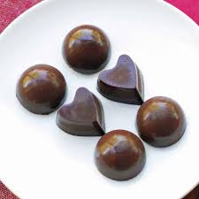
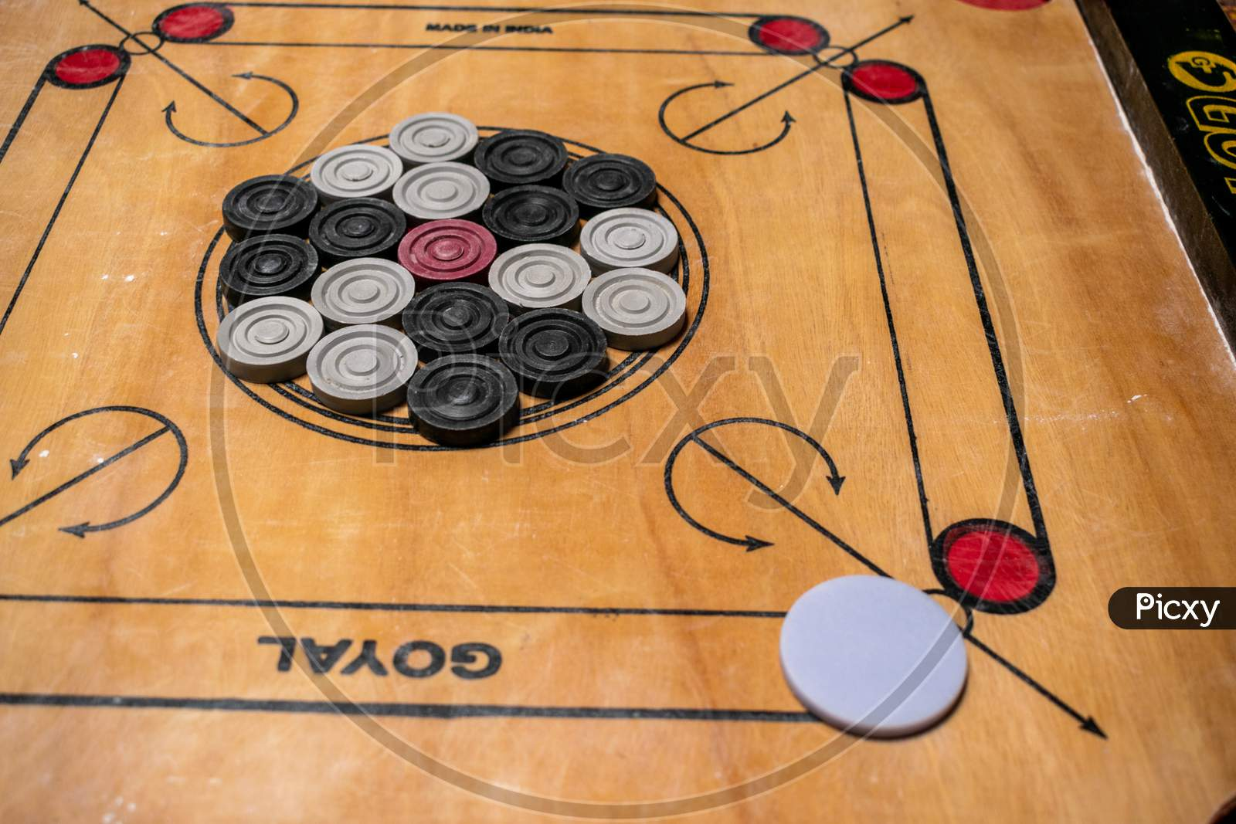
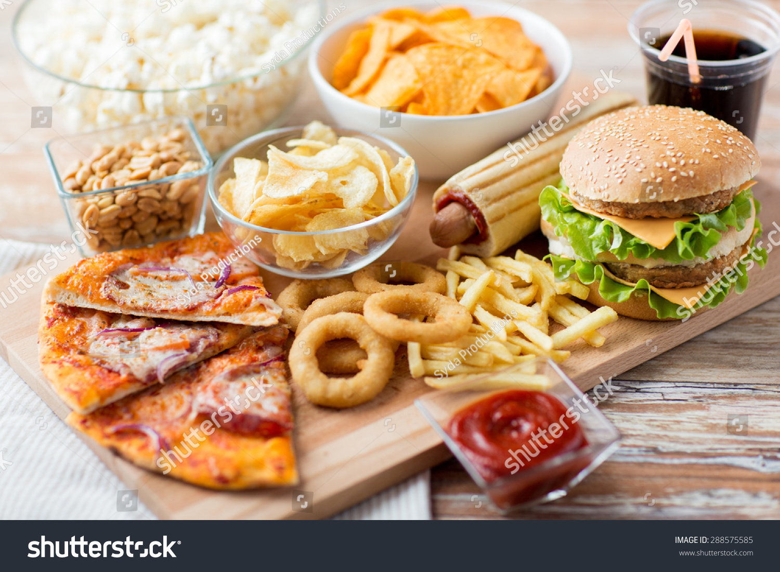
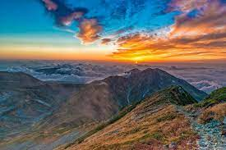

I LOVE….
I Love…
Chocolates.
To play indoor games.
To see thriller and mysterious Movies.
To Read religious books.
To eat fast-food.
To travel mountain places.

Slide 4
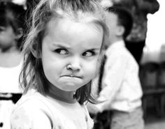
I HATE….
I HATE…
Show-off.
To attend Family functions.
Without logic talks.
Don’t like if any one order me.
If anyone Cheats.

Slide 5
STRENTH
WEAKNESS
THREATS
SWOT
Problem Solving Skill
Easily make connection with others
Customer Friendly Nature
Stage Fear
Not able to represent my Point Of View
OPPORTUNITY
I can analyize customer requirements, So make comfortable atmosphere.
Partnerships
New technology to improve services.
There are many competitor in market.
Economic factors downturns.
AI exploring.

Slide 6

I Strongly believe in Teamwork, Because ….
Alone we can do so little, together we can do so much.

Slide 7
Please keep this slide for attribution

